Slide 1

Customer Analytics
Analysis and Strategies for Avocci LLC. Customer Data
Group 3
Hsin-Yu Chen
Jiaping Du
Tian Tian
Mengxin Tan (Presenter)
Zili Bu
Yuemeng Zhang

Slide 2
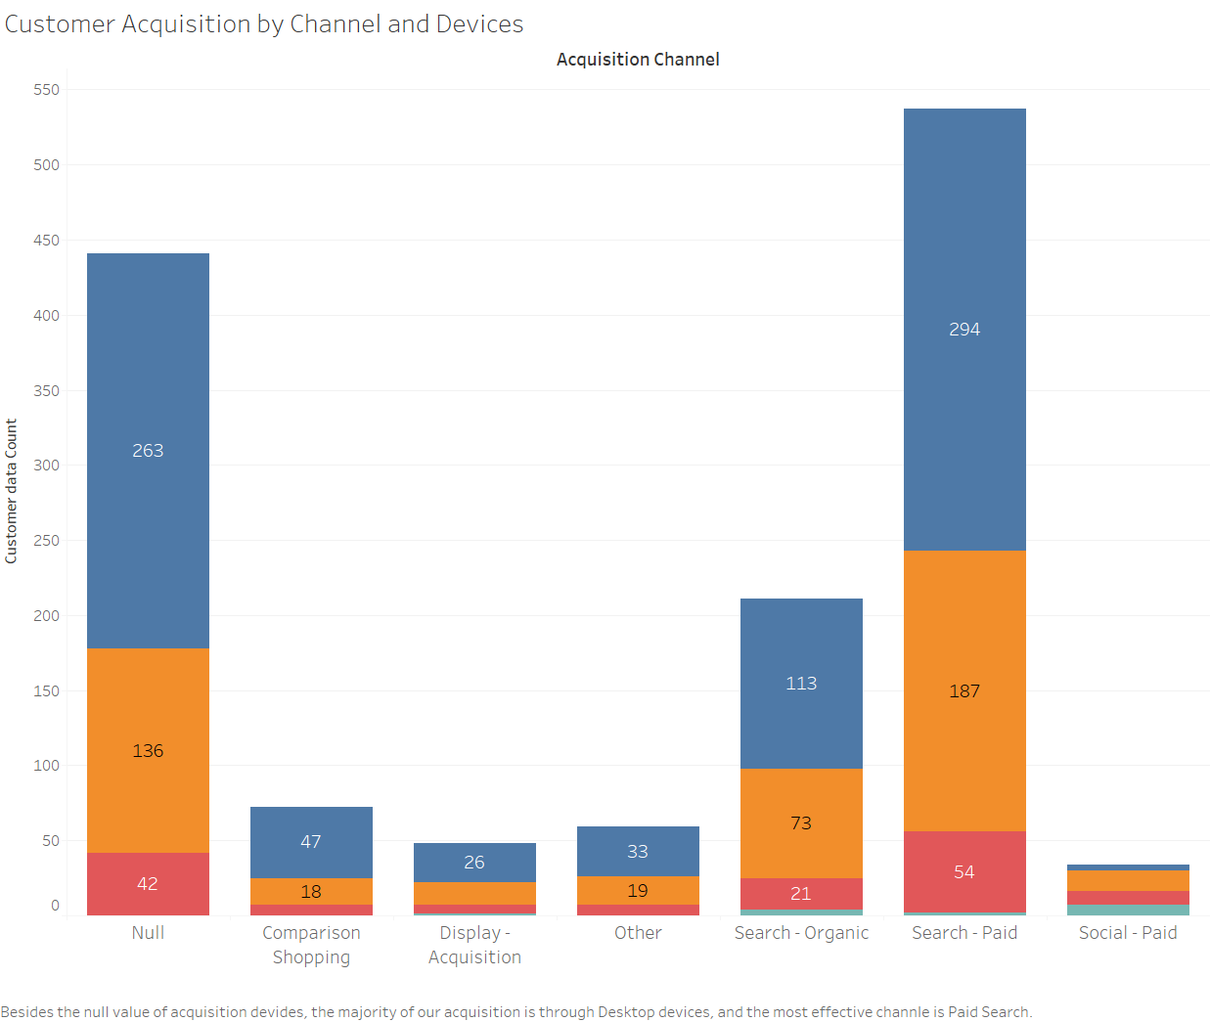
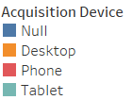
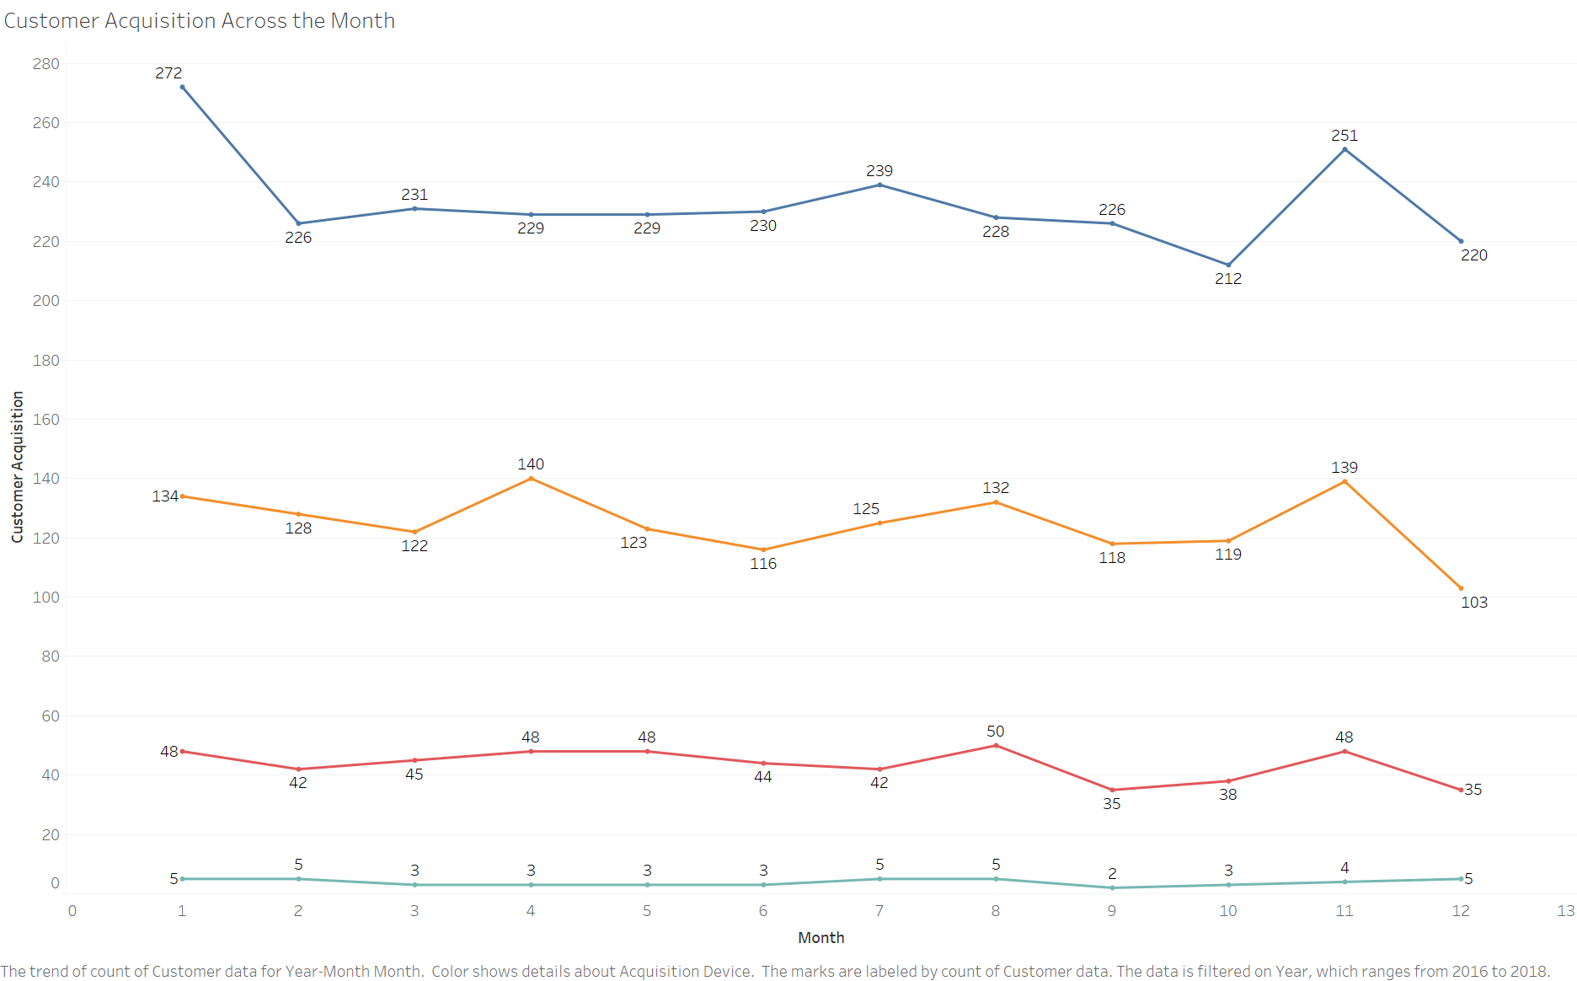
Acquisition
1
The top 3 channels are paid-search, organic search and comparison shopping. Most of the customers are from desktop, only a few from tablet.
Across all months, phone and tablet device are much constant; whereas desktop has two spikes at April and Nov.
Paid search (null has similar behavior) peaked at Jan and Nov. Other two channels has no fluctuations across all months.
Currently heavily rely on paid search customer
There are a lot of Null values that hinder our analysis
Notes:
The top 3 channels are paid-search(537), organic search(211) and comparison shopping(73). Most of the customers are from desktop, only a few from tablet.
Across all months, phone and tablet device are much constant; whereas desktop has two spikes at April and Nov.
Paid search (null has similar behavior) peaked at Jan and Nov, this might indicates the company held some promotions or campaigns. Other two channels has no fluctuations across all months.
Heavily rely on Paid Search Customers, and it is not sustainable due to the sudden drops after the peaks
There are a lot of acquisition dose not have any information(411), it is important to improve our meta data so that we can get more insights.

Slide 3
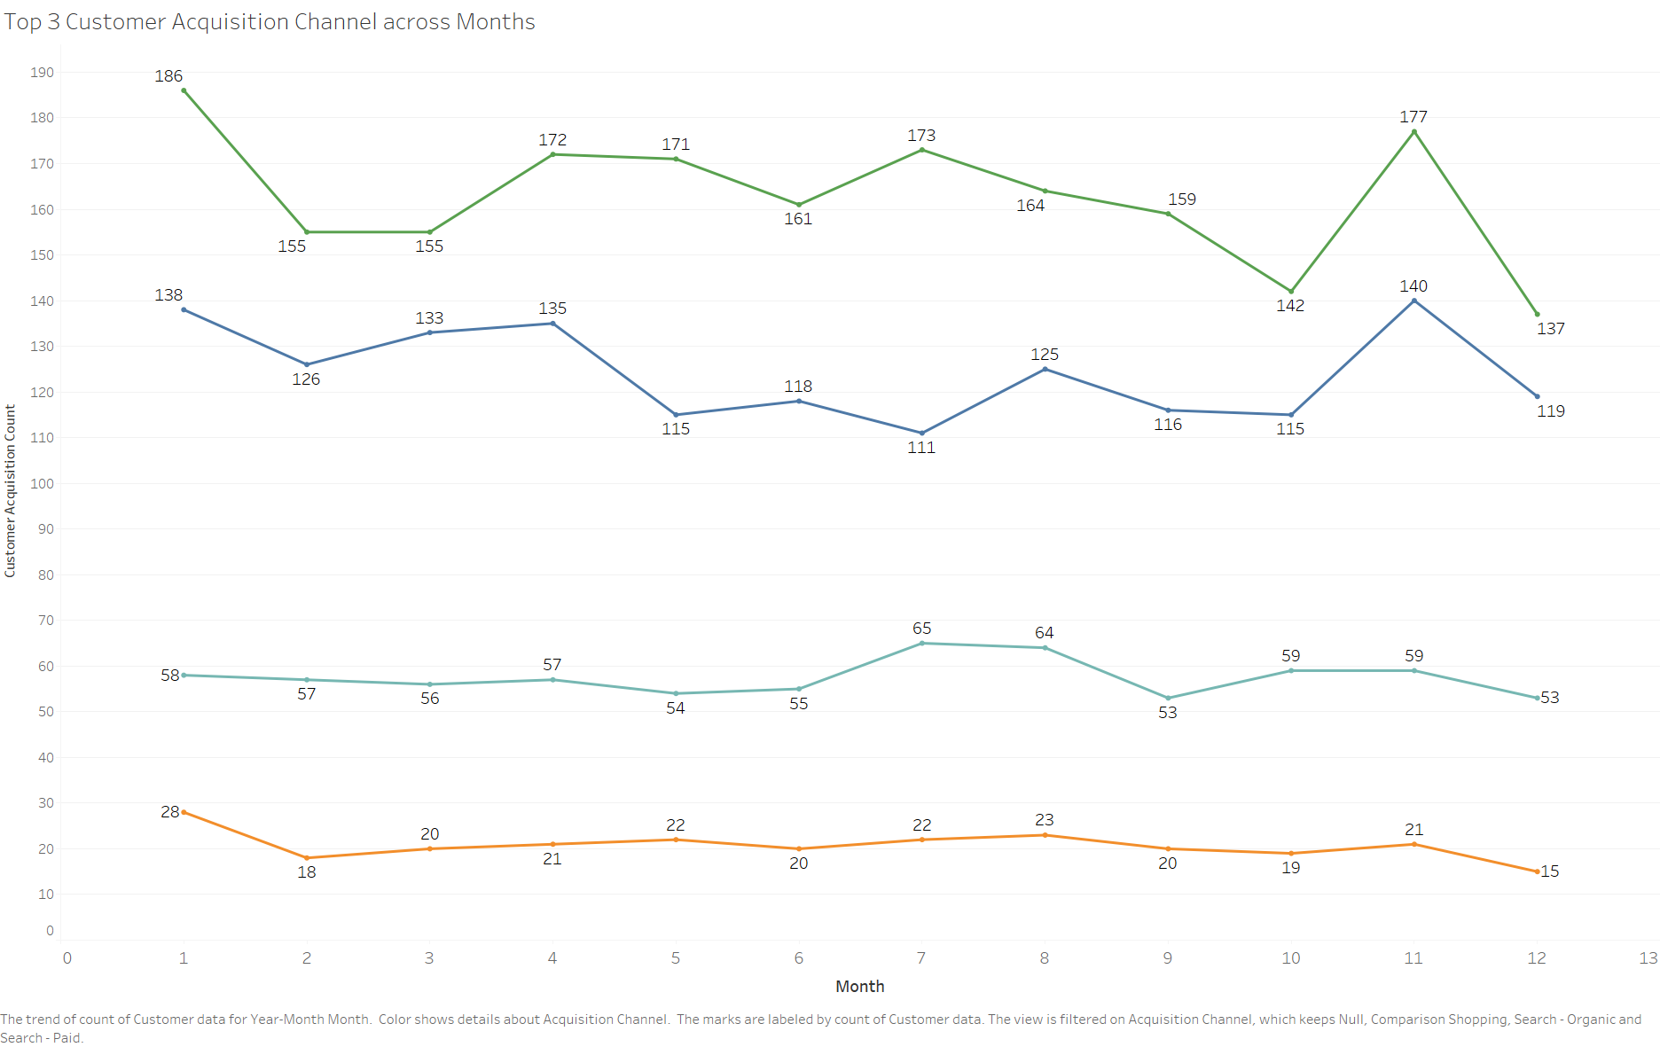
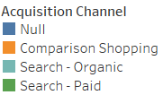
Acquisition
1
The top 3 channels are paid-search, organic search and comparison shopping. Most of the customers are from desktop, only a few from tablet.
Across all months, phone and tablet device are much constant; whereas desktop has two spikes at April and Nov.
Paid search (null has similar behavior) peaked at Jan and Nov. Other two channels has no fluctuations across all months.
Currently heavily rely on paid search customer
There are a lot of Null values that hinder our analysis
Notes:
The top 3 channels are paid-search(537), organic search(211) and comparison shopping(73). Most of the customers are from desktop, only a few from tablet.
Across all months, phone and tablet device are much constant; whereas desktop has two spikes at April and Nov.
Paid search (null has similar behavior) peaked at Jan and Nov, this might indicates the company held some promotions or campaigns. Other two channels has no fluctuations across all months.
Heavily rely on Paid Search Customers, and it is not sustainable due to the sudden drops after the peaks
There are a lot of acquisition dose not have any information(411), it is important to improve our meta data so that we can get more insights.

Slide 4
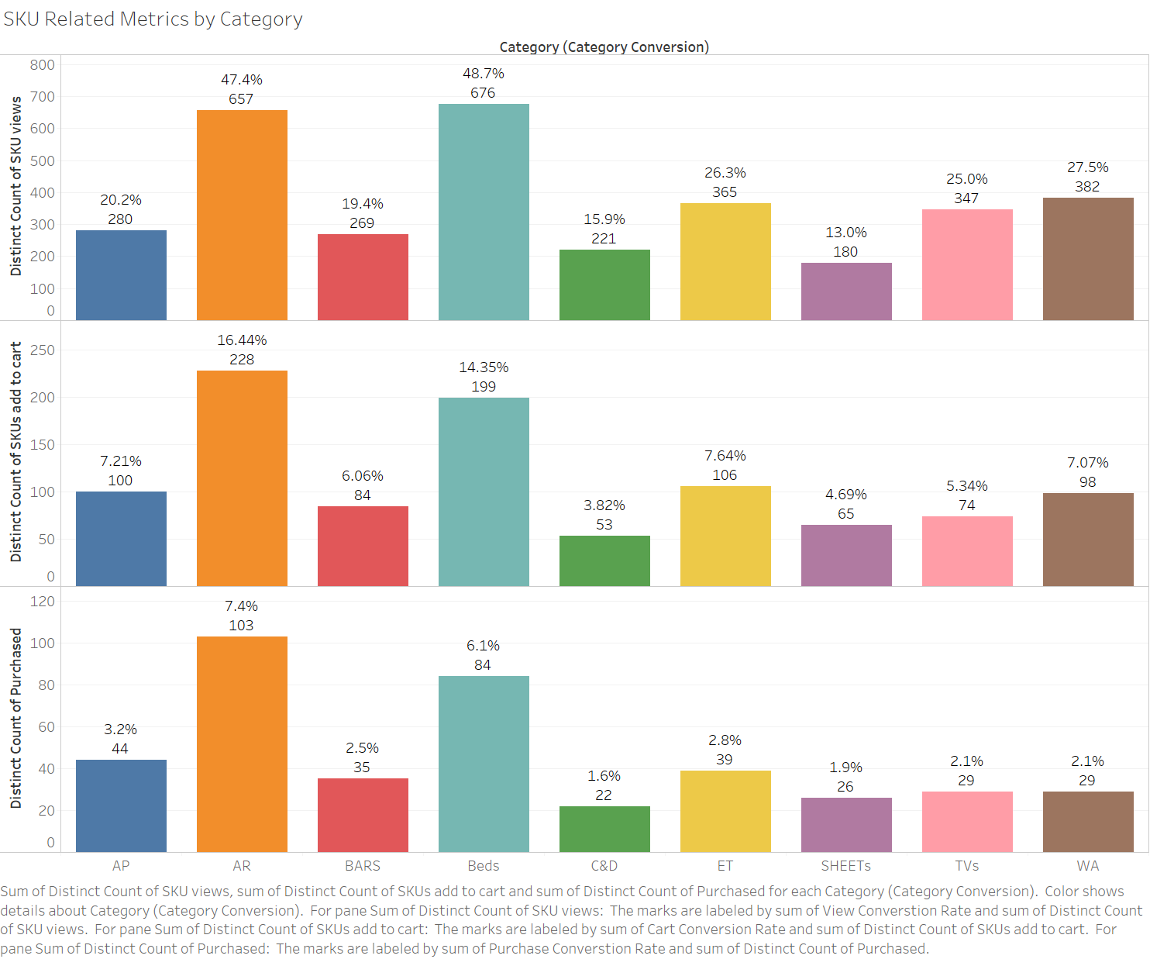
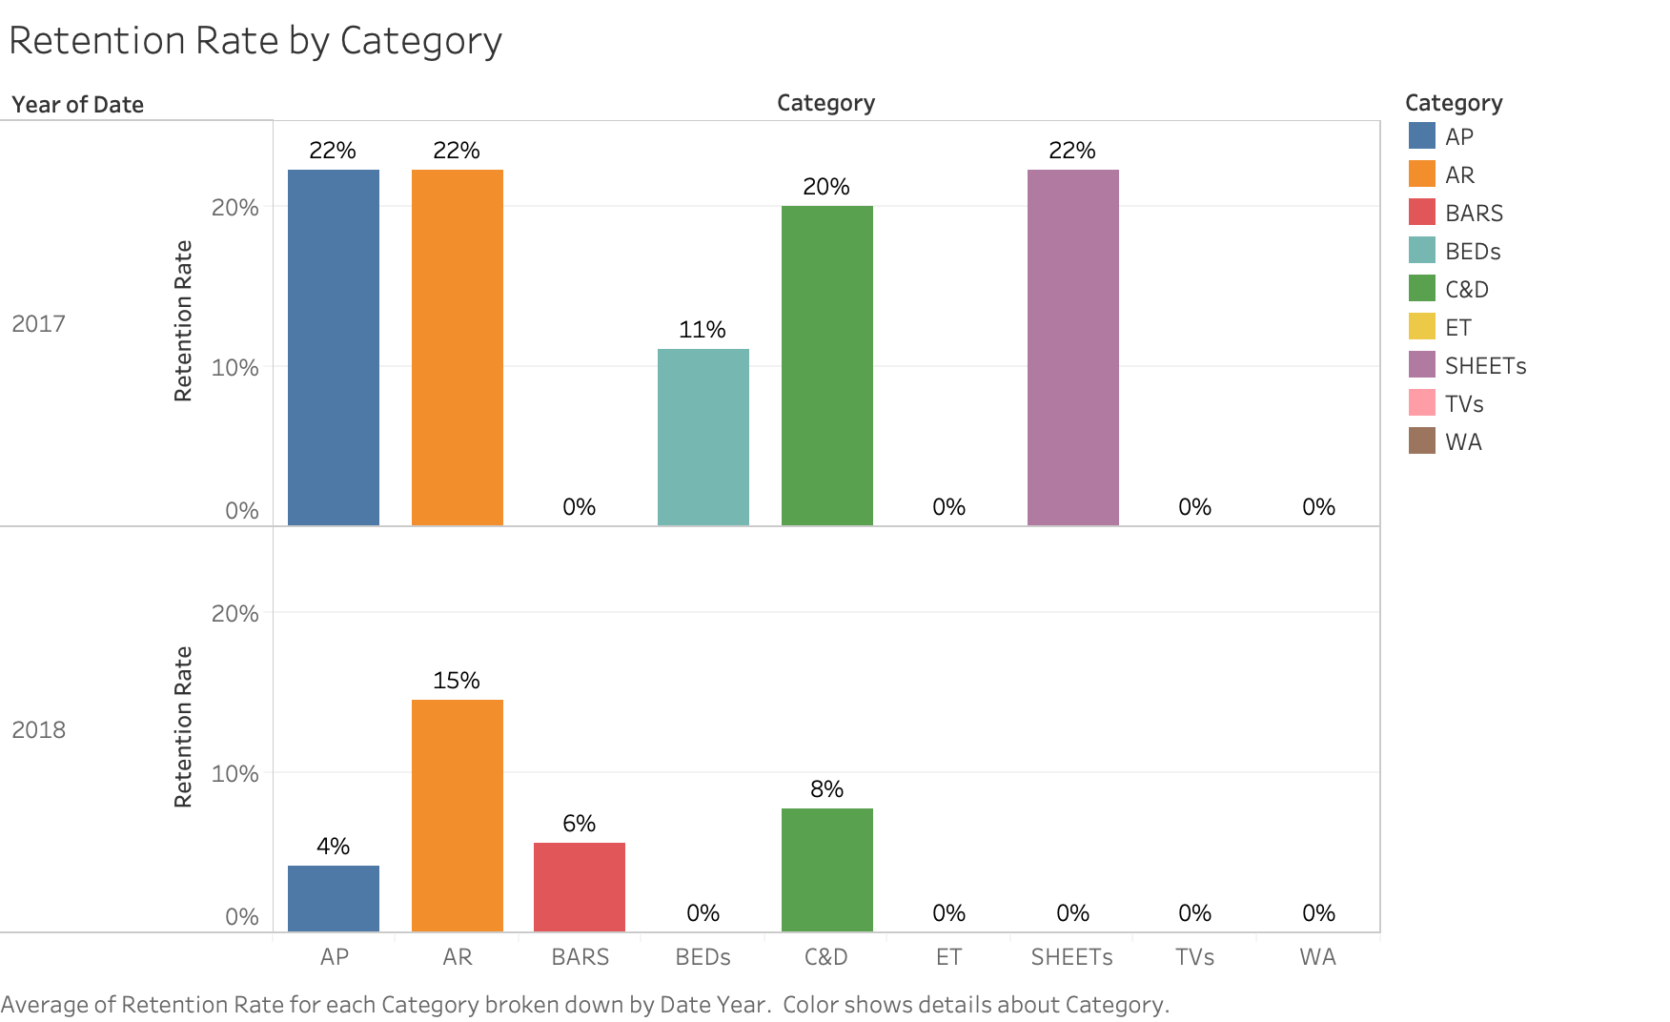
Activations and Conversions
2
Category:
Standouts: AR & Beds
Low purchase conversions of others
E-commerce average: 3%
Devices:
Standout: Desktop
Tablet: lowest conversion rate and smallest number of customers gained
Further information to fill the null set
Channels:
Standout: Paid Search
Noticeable: Organic Search
Low performance: social media paid
Notes:
Definition of all three conversion rate is the % of total customers who have such actions (views, add to cart, and purchased)
Categories: The top two categories are AR and Beds from SKU views to SKU purchased, other categories are relatively low on purchase conversions. (3% ecommerce benchmark
Devices: Ignore the null value, desktop has the best conversion rate overall. We might think about drop tablet devices because both number of customers and the overall conversions are very low. We definitely need to collect more information of these null values because they are the majority of our data, and we need to investigate them to understand the how different devices work.
Channels: Paid search is also our top performance channel for SKU related parameters. In fact, the purchase conversion rates is higher than the industry benchmark(means what?). Organic search is pretty good given the nature that they are free source of customers, we should keep up this channel. Other channels, especially social media paid channel, are not very efficient and we should think about the budgets spending on them.

Slide 5
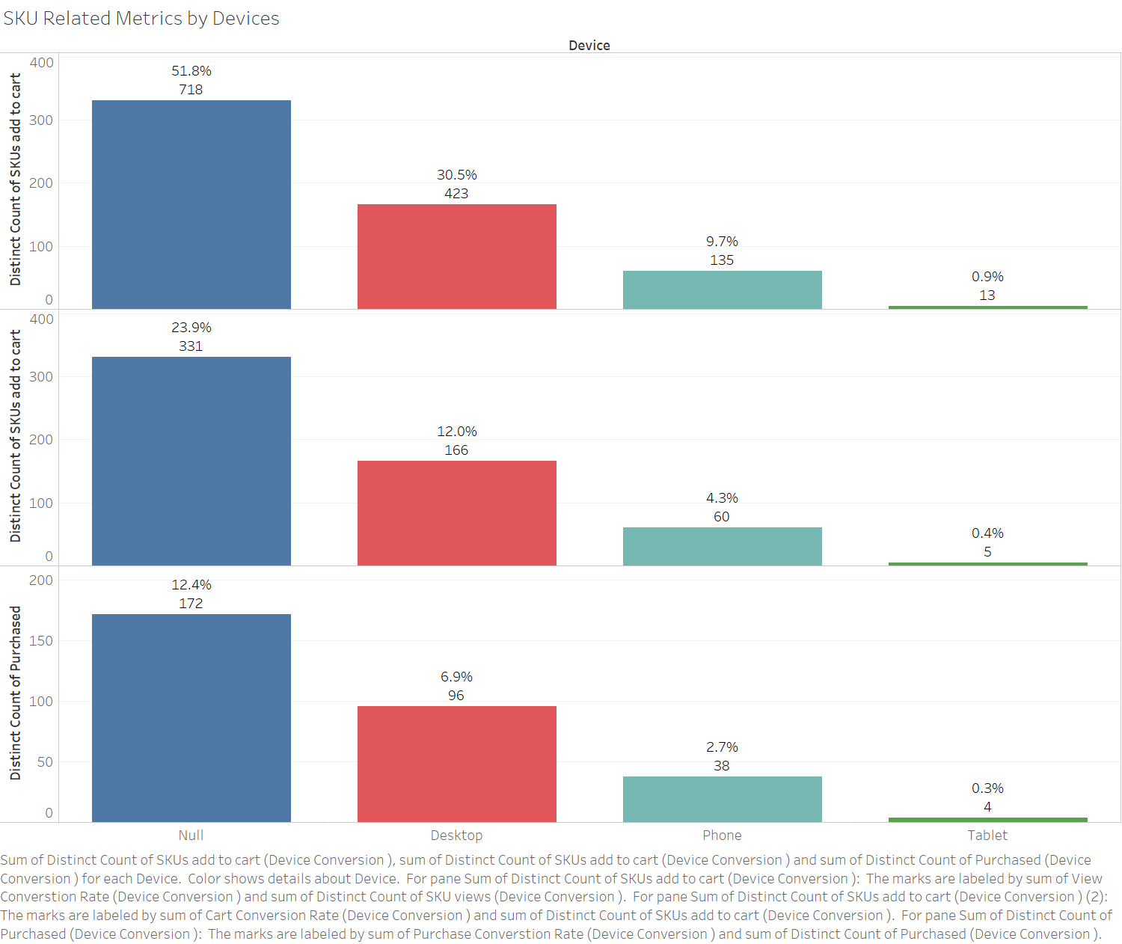
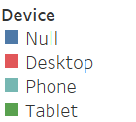
Activations and Conversions
2
Category:
Standouts: AR & Beds
Low purchase conversions of others
E-commerce average: 3%
Devices:
Standout: Desktop
Tablet: lowest conversion rate and smallest number of customers gained
Further information to fill the null set
Channels:
Standout: Paid Search
Noticeable: Organic Search
Low performance: social media paid
Notes:
Definition of all three conversion rate is the % of total customers who have such actions (views, add to cart, and purchased)
Categories: The top two categories are AR and Beds from SKU views to SKU purchased, other categories are relatively low on purchase conversions. (3% ecommerce benchmark
Devices: Ignore the null value, desktop has the best conversion rate overall. We might think about drop tablet devices because both number of customers and the overall conversions are very low. We definitely need to collect more information of these null values because they are the majority of our data, and we need to investigate them to understand the how different devices work.
Channels: Paid search is also our top performance channel for SKU related parameters. In fact, the purchase conversion rates is higher than the industry benchmark(means what?). Organic search is pretty good given the nature that they are free source of customers, we should keep up this channel. Other channels, especially social media paid channel, are not very efficient and we should think about the budgets spending on them.

Slide 6
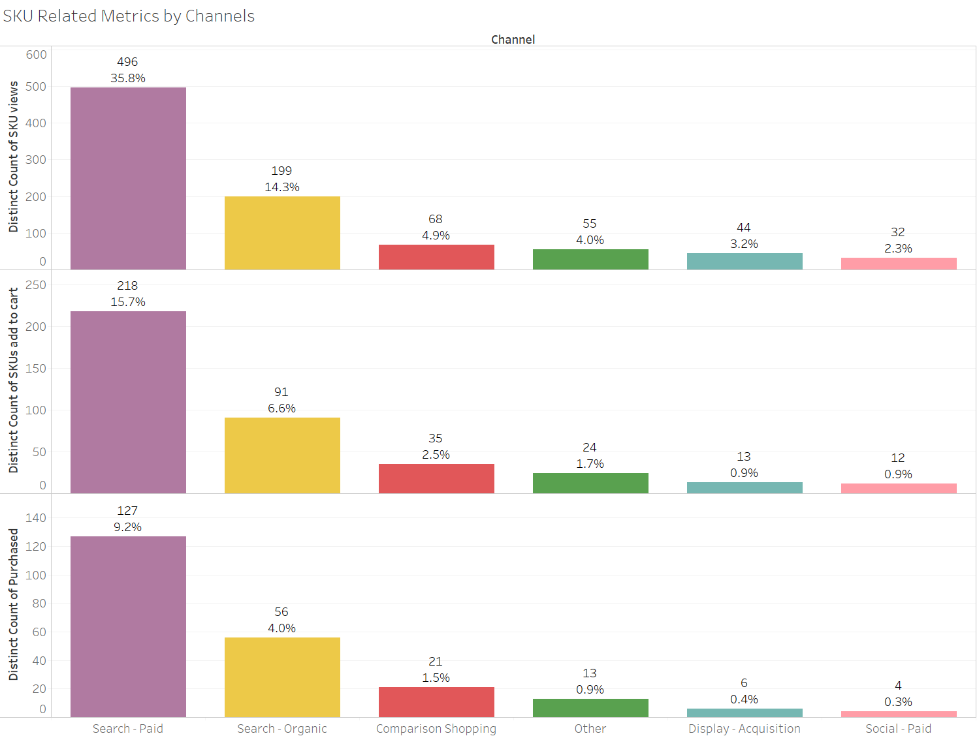
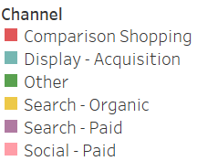
Activations and Conversions
2
Category:
Standouts: AR & Beds
Low purchase conversions of others
E-commerce average: 3%
Devices:
Standout: Desktop
Tablet: lowest conversion rate and smallest number of customers gained
Further information to fill the null set
Channels:
Standout: Paid Search
Noticeable: Organic Search
Low performance: social media paid
Notes:
Definition of all three conversion rate is the % of total customers who have such actions (views, add to cart, and purchased)
Categories: The top two categories are AR and Beds from SKU views to SKU purchased, other categories are relatively low on purchase conversions. (3% ecommerce benchmark
Devices: Ignore the null value, desktop has the best conversion rate overall. We might think about drop tablet devices because both number of customers and the overall conversions are very low. We definitely need to collect more information of these null values because they are the majority of our data, and we need to investigate them to understand the how different devices work.
Channels: Paid search is also our top performance channel for SKU related parameters. In fact, the purchase conversion rates is higher than the industry benchmark(means what?). Organic search is pretty good given the nature that they are free source of customers, we should keep up this channel. Other channels, especially social media paid channel, are not very efficient and we should think about the budgets spending on them.

Slide 7
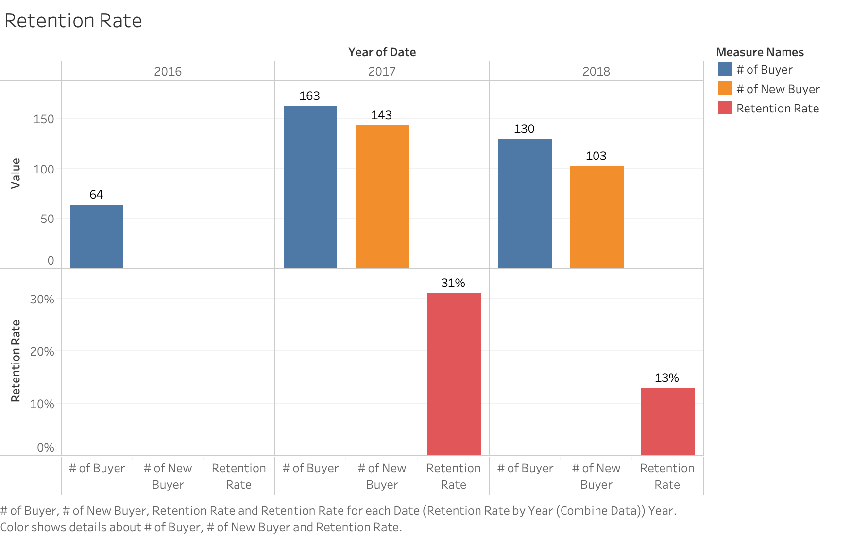
Retention
3
Overall the retention rate in 2017 is not bad.
Product categories such as ET, TVs, and WA retention rates are all zero in 2017 and 2018. There are no repeat buyers.
Sheets declined most from 2017 to 2018.
AR performs relatively better than other categories in both years.
Notes:
Insights & Recommendations:
Retention rate for 2017 is not bad. Build RFM model will be helpful for segmenting and better knowing customers to improve retention rate.
Product categories such as ET, TVs, and WA retention rates are all zero in 2017 and 2018. ( will need to dig into the reasons to find out why. Whether the product does not belong to a daily essential or whether former buyers complained about the products in the reviews)
Sheets declined most from 2017 to 2018. No repeat buyers.
AR performs relatively better than other categories in both years.

Slide 8
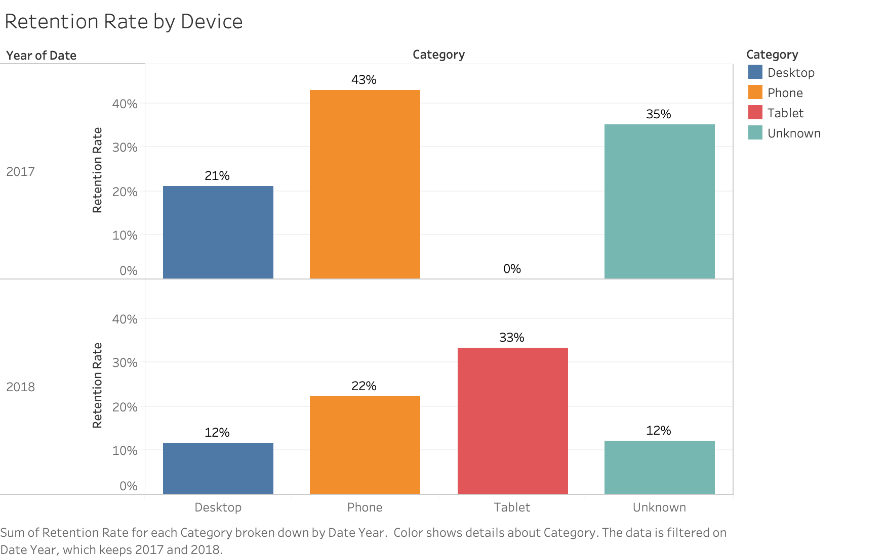
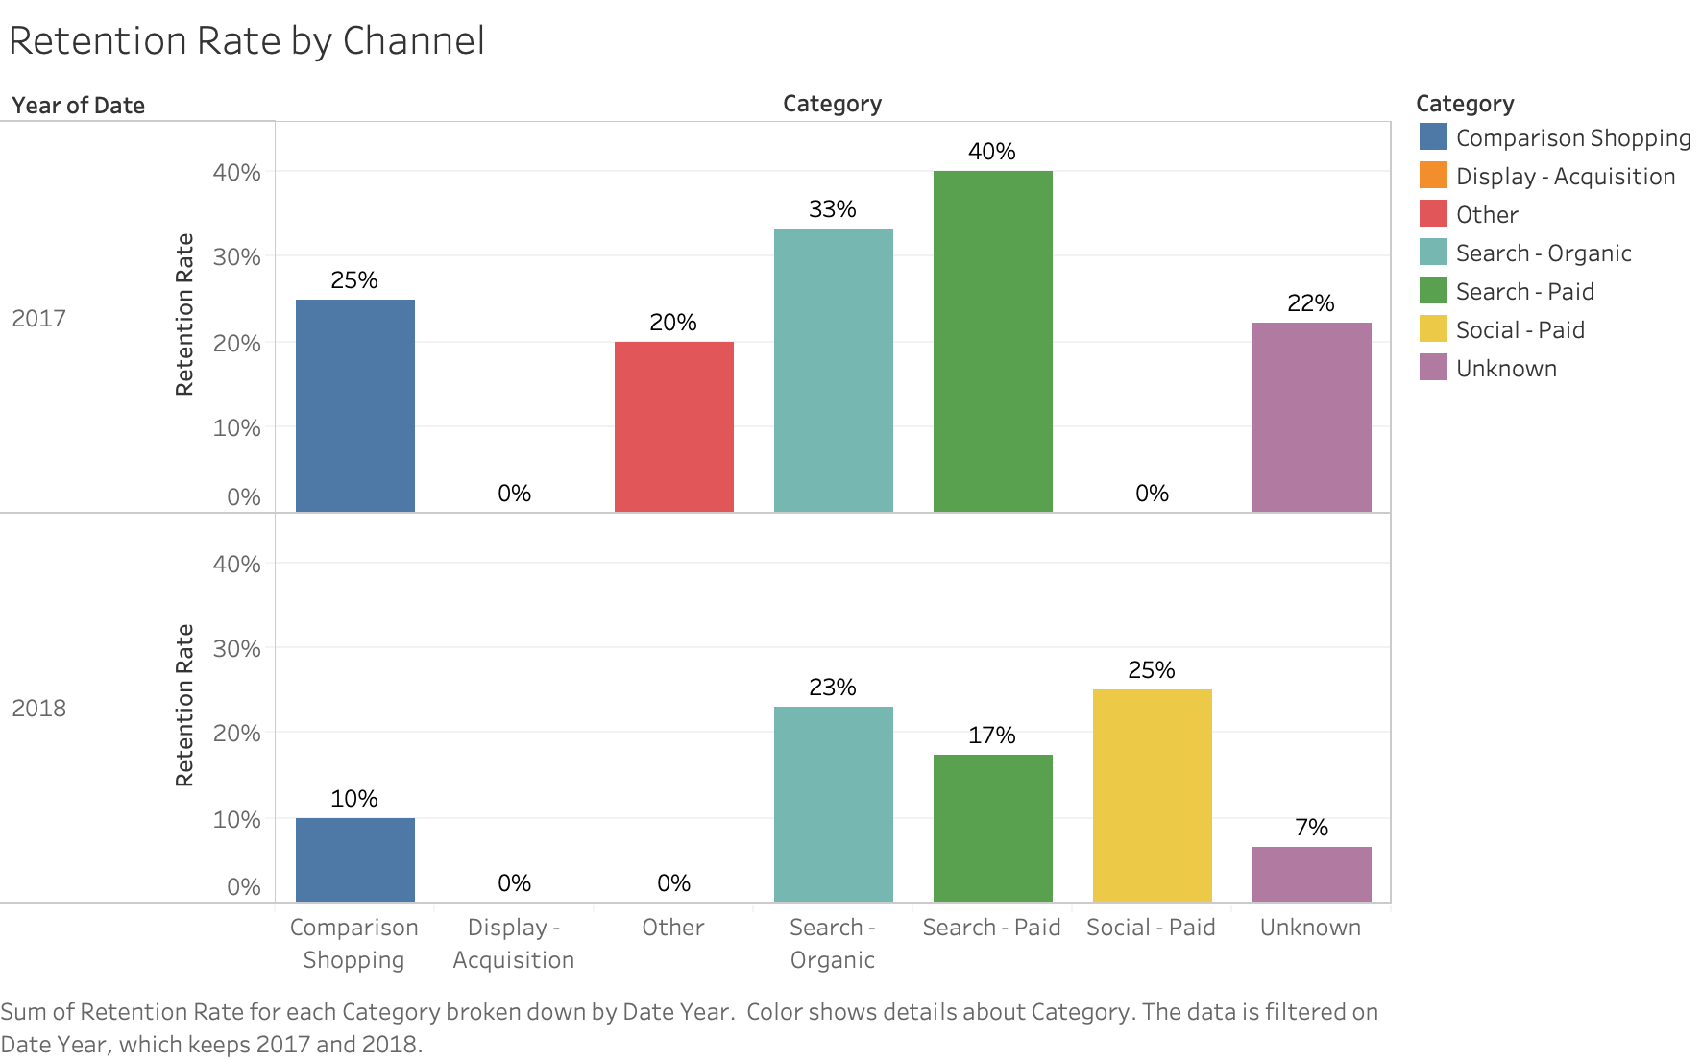
Retention
4
Device
Retention rate of Phone device is relatively higher compared to other devices in 2017 and 2018.
Channel
Overall retention rate declined from 2017 to 2018 in almost all channels. However, the level of retention rate declined in 2018 is the lightest for Search Organic.
Search Paid has the highest retention rate in 2017, but declined the most in 2018.
Notes:
Insights & Recommendations:
From the device perspective:
Retention rate of Phone device is relatively higher compared to other devices in 2017 and 2018. (This insight can also support the recommendation mentioned in RFM model)
Although in 2018 Tablet has the highest retention rate, the proportion of customers coming from Tablet is small.
From channel perspective:
Retention rate declined from 2017 to 2018 in almost all channel, except for Social-Paid.
Retention rate of Display are zero in both years. The proportion of customers coming from Display is small. No repeat buyers.
Search Paid has the highest retention rate in 2017, but declined the most in 2018.
The level of retention rate declined in 2018 is the lightest for Search Organic.(Echo with the part in RFM model. In RFM model part mention that we can promote organic search)

Slide 9
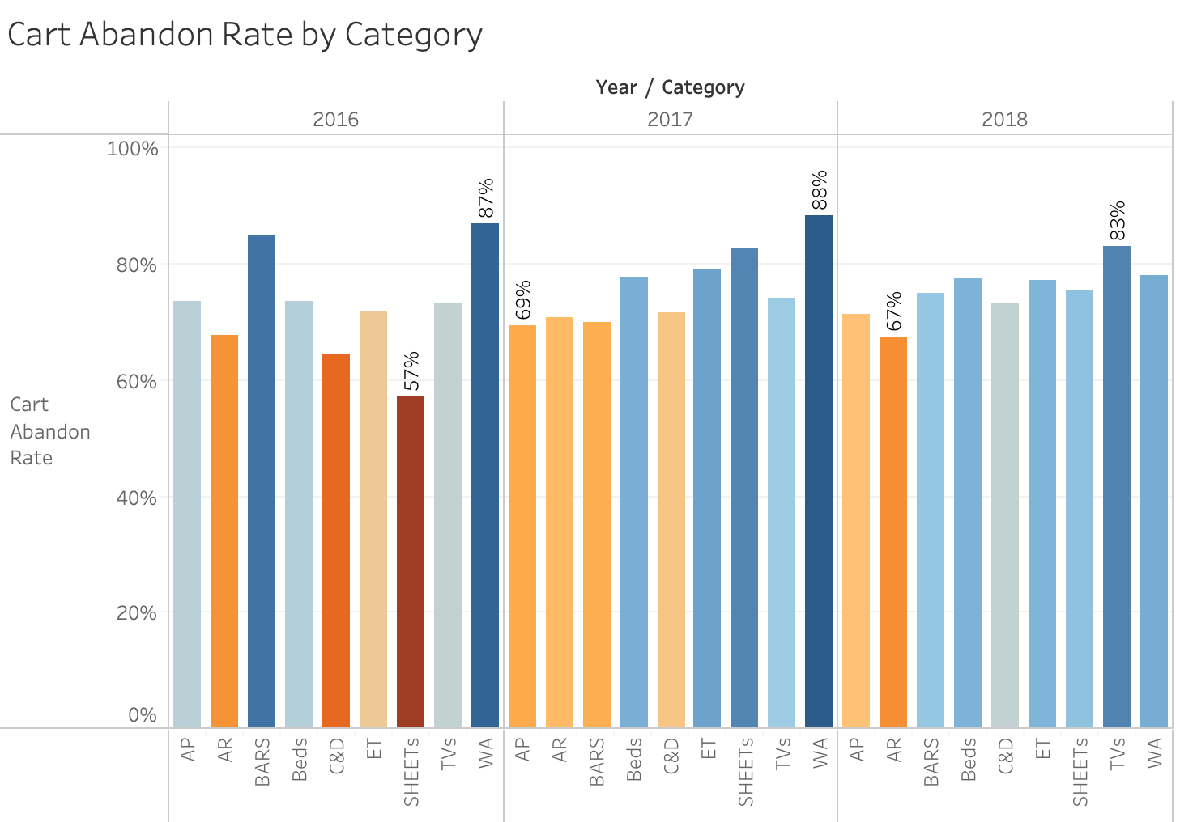
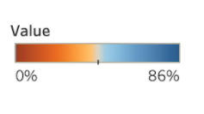
Retention - Cart Abandon Rate
5
Category:
Low abandon rate of Sheets products in 2016
WA products always have a high level of abandon
Generally same levels across years
Device:
Low abandon rate and few customer gained from Tablet devices, but the highest in 2018
Channel:
Comparison shopping is increasing by years
Social-Paid channel remains a high level of abandon rate
Notes:
Insights & Recommendations:
Cart Abandon Rate: May 2017 has the highest, December 2017 has the lowest.
View Abandon Rate: February 2017 has the highest, February 2018 has the lowest.
May refer to other metrics to find the implicit reason
There is a constant fluctuating pattern month by month, one month higher, the following month would be lower.

Slide 10
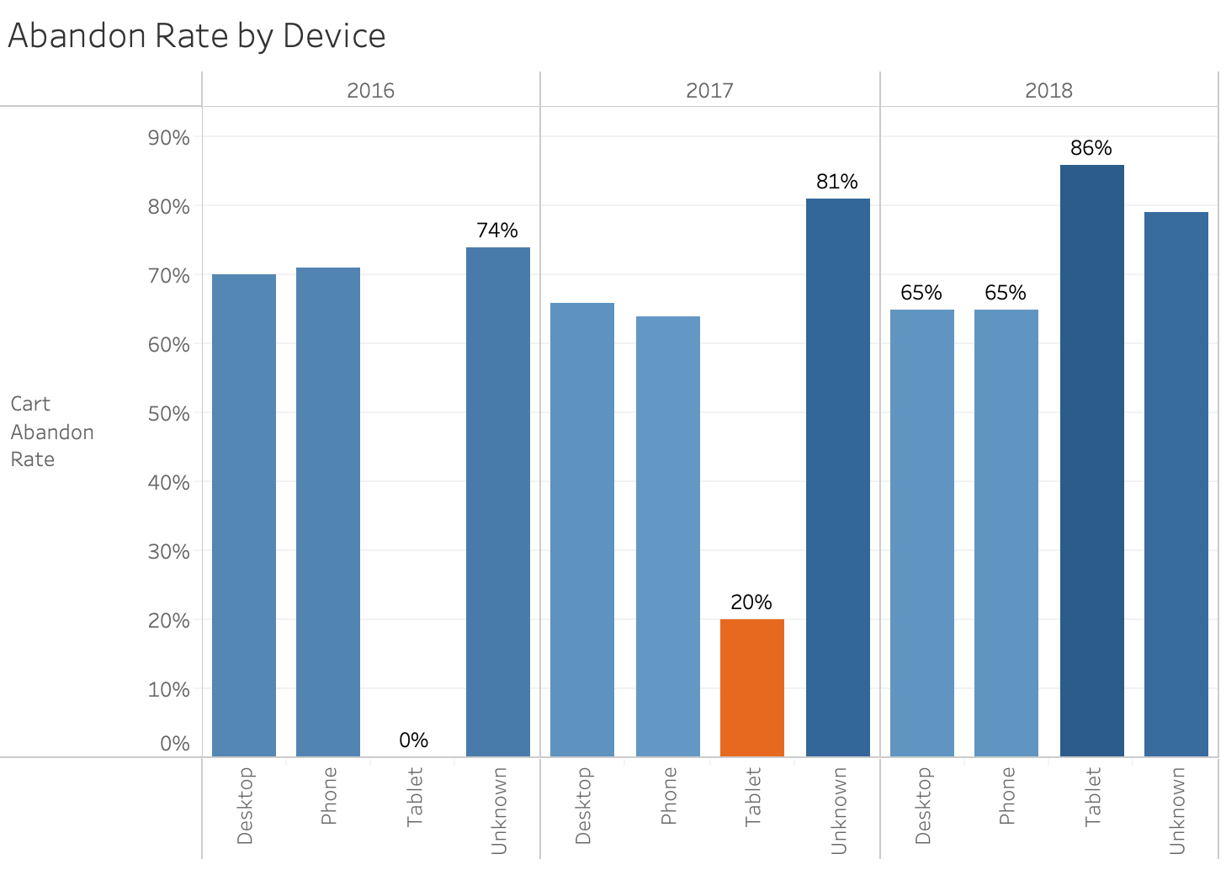
Retention - Cart Abandon Rate
5
Category:
Low abandon rate of Sheets products in 2016
WA products always have a high level of abandon
Generally same levels across years
Device:
Low abandon rate and few customer gained from Tablet devices, but the highest in 2018
Channel:
Comparison shopping is increasing by years
Social-Paid channel remains a high level of abandon rate
Notes:
Insights & Recommendations:
Cart Abandon Rate: May 2017 has the highest, December 2017 has the lowest.
View Abandon Rate: February 2017 has the highest, February 2018 has the lowest.
May refer to other metrics to find the implicit reason
There is a constant fluctuating pattern month by month, one month higher, the following month would be lower.

Slide 11
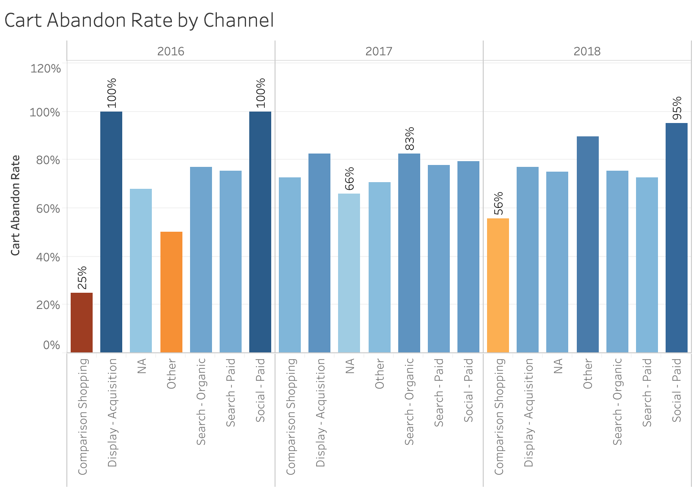
Retention - Cart Abandon Rate
5
Category:
Low abandon rate of Sheets products in 2016
WA products always have a high level of abandon
Generally same levels across years
Device:
Low abandon rate and few customer gained from Tablet devices, but the highest in 2018
Channel:
Comparison shopping is increasing by years
Social-Paid channel remains a high level of abandon rate
Notes:
Insights & Recommendations:
Cart Abandon Rate: May 2017 has the highest, December 2017 has the lowest.
View Abandon Rate: February 2017 has the highest, February 2018 has the lowest.
May refer to other metrics to find the implicit reason
There is a constant fluctuating pattern month by month, one month higher, the following month would be lower.

Slide 12
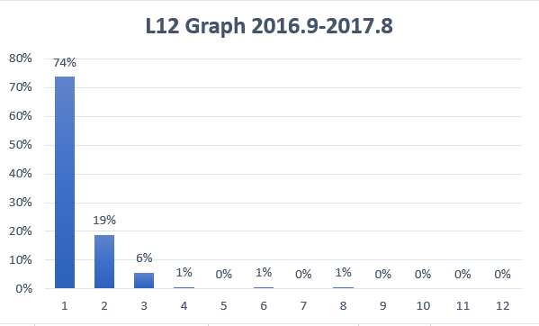
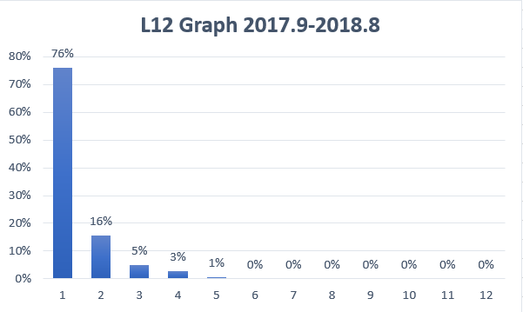
Retention - Power User Comparison
6
Definition: Customers who have at least one purchase among a 12-month period
Power users move slightly towards right

Slide 13
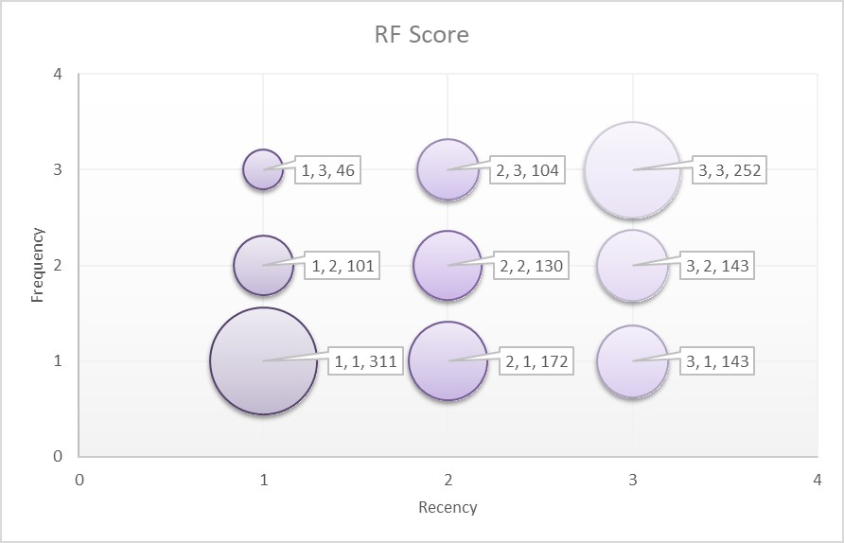
Revenue - Analysis Based on RFM Model
7
Data Analysis
Used “qcut” function in Python to generate trisection
Recency/Frequency: based on views
Monetary Value: based on purchases
Insights
Champions: (3, 3, 252)
At Risk: (2, 1, 172), (2, 2, 130)
Lost: (1, 1, 311)

Slide 14
Revenue - Strategies for RF Analysis
8
1
2
3
Champions
At Risk
Lost
Follow up these customers, send out emails and questionnaires for feedback
Promote affiliate programs primarily on these customers
Investigate their behaviors and find out what happened for these customers who used to be Champions
Design promotion specifically for these customers for the ROI would be huge
Send them crazy coupon or promotion that they cannot refuse
Push the brand advertisement for this group to let them re-warm the prospect to our brand and product.

Slide 15
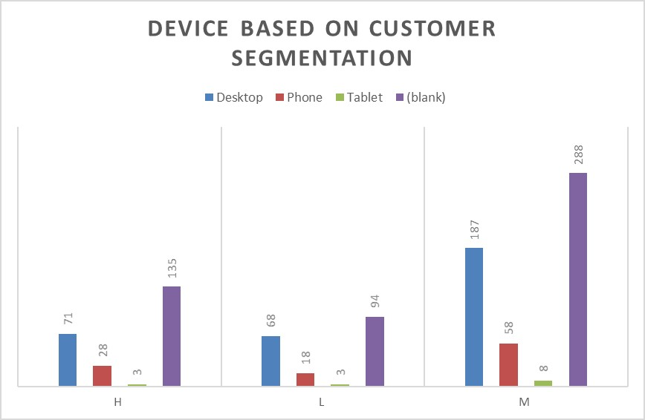
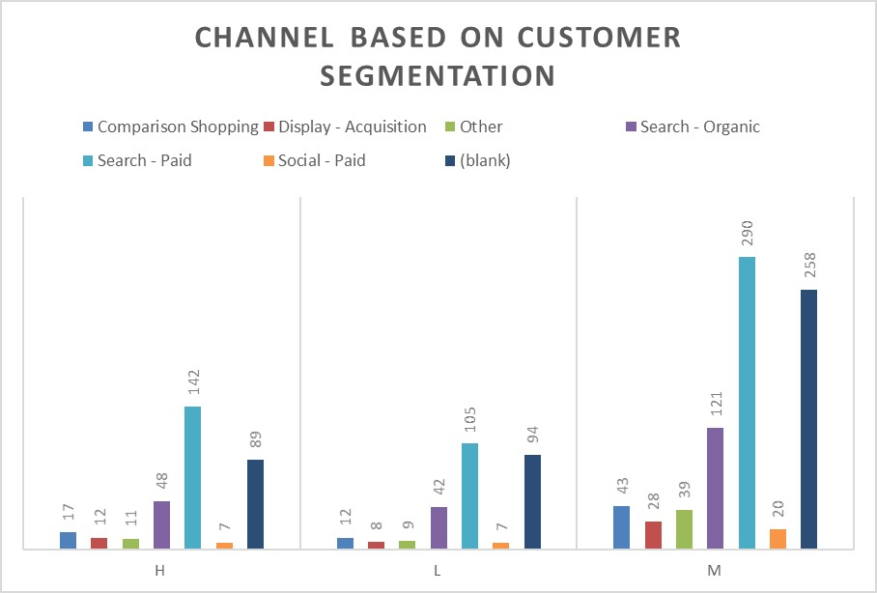
Revenue - Customer Segmentation
9
Device
Channel
Most the High value customer are acquired from Desktop device
Tablet acquisition channel plays a very tiny role in acquiring both group of customer
We need to enhance the acquisition strategy for Phone device because it has a big potential to acquire more customers, especially the High-value customer.
The general trend of acquisition channel across three levels of customers is the same.
Paid search contributes the most to all the acquisition
The company should try to promote organic search and comparison for which are free and effective

Slide 16
Recommendations
10
1
2
3
Channel
Category
Device
Improve organic search, making good use of network effect and raising the awareness of the company brand
Include cost of paid search as part of the analysis; explore the reason behind the fluctuations in Nov. and Jan.
Reconsider budget for paid social, taking CAC into account, for it is not an effective channel for acquisition based the given data
Ensure category TVs, WA and Sheets product page to be attractive to customers and to convey clear information about the product
Improve product performance ET, TVs, and WA by investigating from customer product reviews
Keep up the performance of AR and Beds
Enhance the UI of the company’s website in cell phone browser or APPs; increase the landing rate and smooth the conversion process on cell phone
Improve data quality; explore the null data

